Slide 1

Stage 6 Me Frosted Lucky Charms Course Designer: Eric Beerbaum
Me Frosted Lucky Charms is a 19 round, 95 point Comstock medium course. There are 8 USPSA targets and 3 poppers. The best two hits per target will score. The start signal is audible
The Handgun start position is standing facing downrange with toes touching Xs and wrists below belt. Handgun is loaded and holstered The PCC start position is standing facing downrange with toes touching Xs and PCC loaded with stock touching belt.
On the audible start signal, engage targets from within the shooting areas.

Slide 2
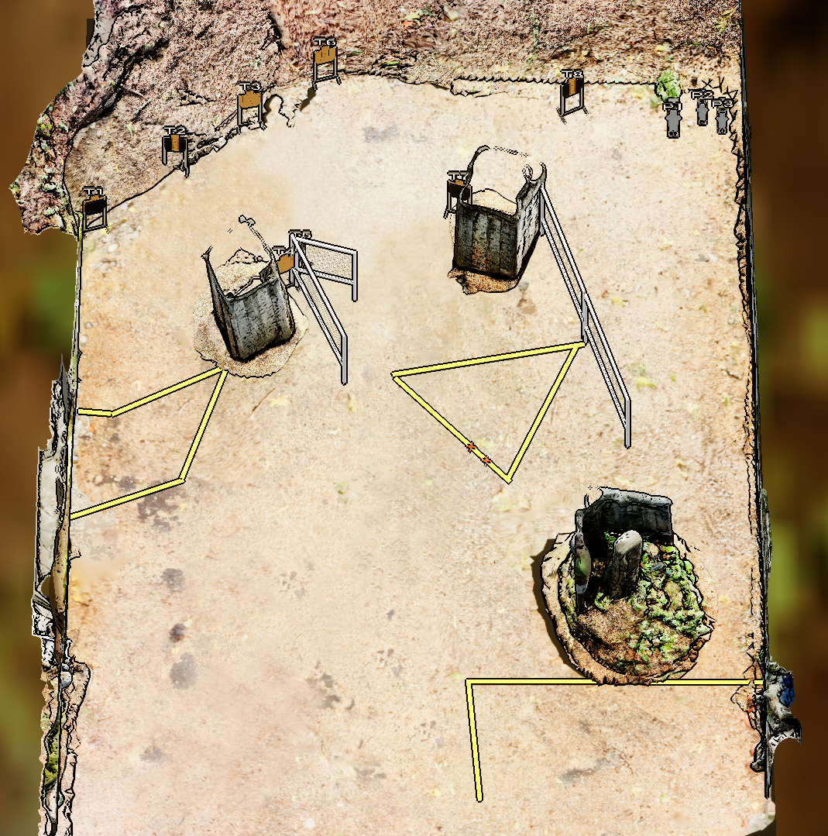
 | Stage 6 Me Frosted Lucky Charms Course Designer: Eric Beerbaum

